Slide 1
Glacier Travel I
Aaron Yahr
1 November 2010

Slide 2
Reference Outline
Glacier definition
Zones and crevasses
Features and hazards
Snowbridges
Climates
Rope team set up
Roped Travel
Routefinding

Slide 3
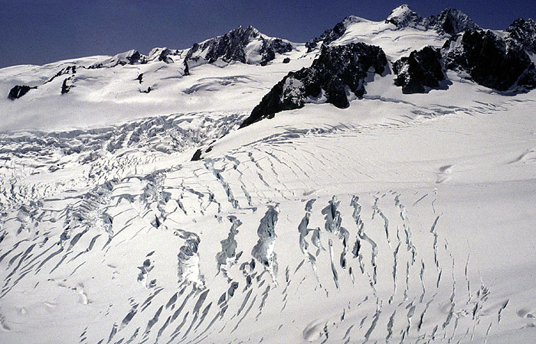
Glaciers

Slide 4
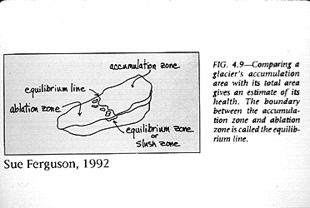
Glaciers
Form in areas that receive more snow than can melt in a given year
Snow compresses; turns to ice in several to 100 years depending on climate
Ice grows in size and moves – motion key to definition of glacier (vs snowfield)
Accumulation zone – new snow falls (upper glacier)
Abalation zone – where ice has moved down to (lower glacier)

Slide 5
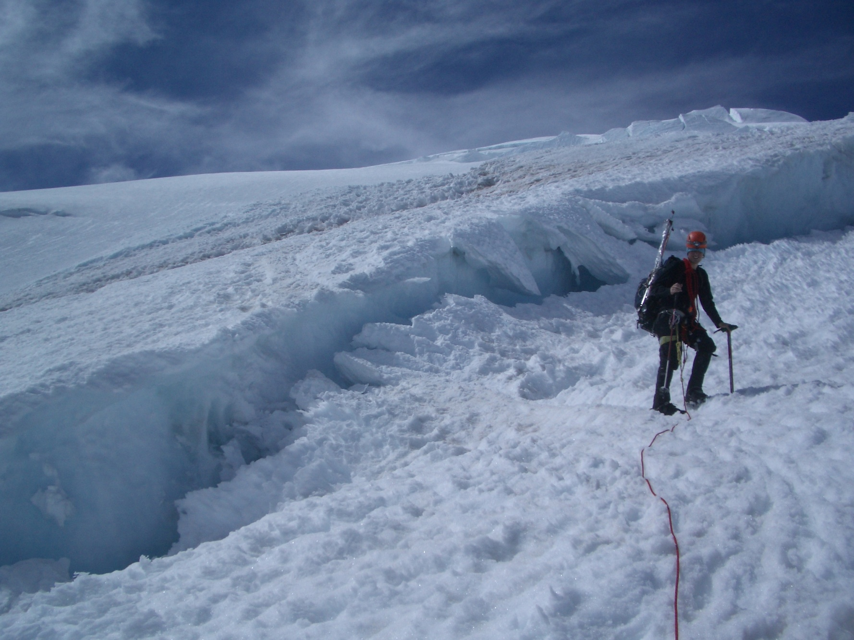
Zones and Crevasses

Slide 6
Zones and Crevasses
Crevasses form from the tension that occurs when some ice moves faster than other adjacent ice
Tension zone – e.g. sharp angled slope; surface ice must travel farther than ice at bedrock
Compression zone – e.g. base of slope; crevasses filled in by pooling
Transverse crevasses – perpendicular to glacier flow; on simple slope forms as series of parallel crevasses
Marginal crevasses – angle up glacier at 45; form on edge of rock wall and often widen toward center of glacier
Radial crevasses – form at turn or where glacier flows cross one another
Bergschrund – upper most crevasse; usually just below steep headwall and often wide and long

Slide 7
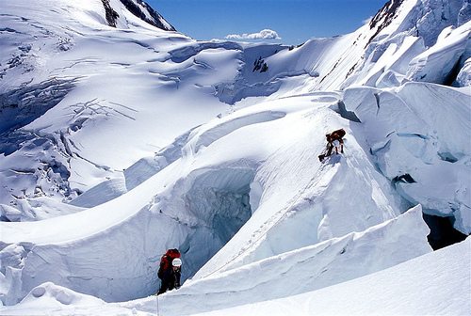
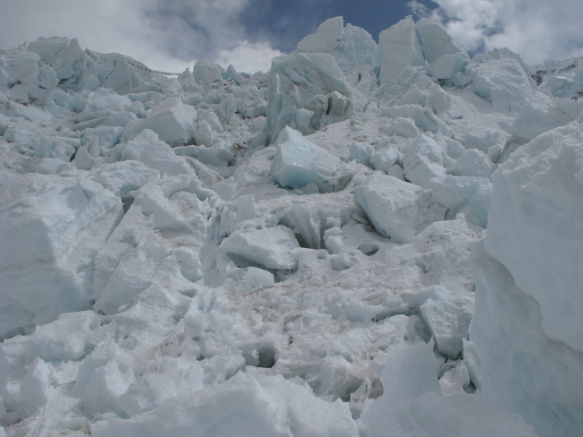
Features and hazards
Seracs
Icefall

Slide 8
Features and hazards
Icefall
  chaotic structure resulting from glacier traversing rough terrain
  generally refers to glacial region, “serac fall” usually used to indicate hazard of ice falling onto you (instead of “ice fall”)
Seracs
  Large towers or blocks of ice
  May fall onto the route or onto you
  How to identify risk
    Look for debris on ground
    Guidebook!
    Listen for crashing (also in the night)

Slide 9
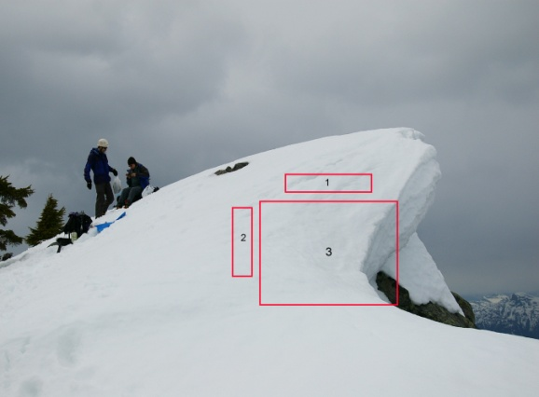
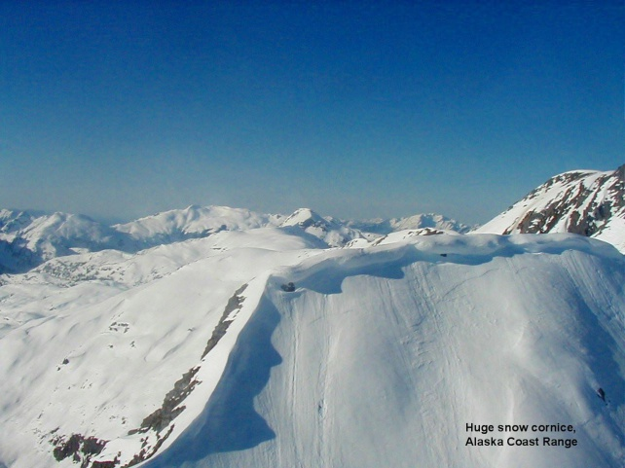
Features and hazards
Moats
  Melt gaps between glacier and rock wall
  May become dicer farther into summer
  Can be deep and over hung with weak snow
  Listen for flowing water
Cornice
  When on crevasses will eventually form snowbridges
  Build up of overhanging snow along on edge
  Unstable - avoid travel on
Avalanches

Slide 10
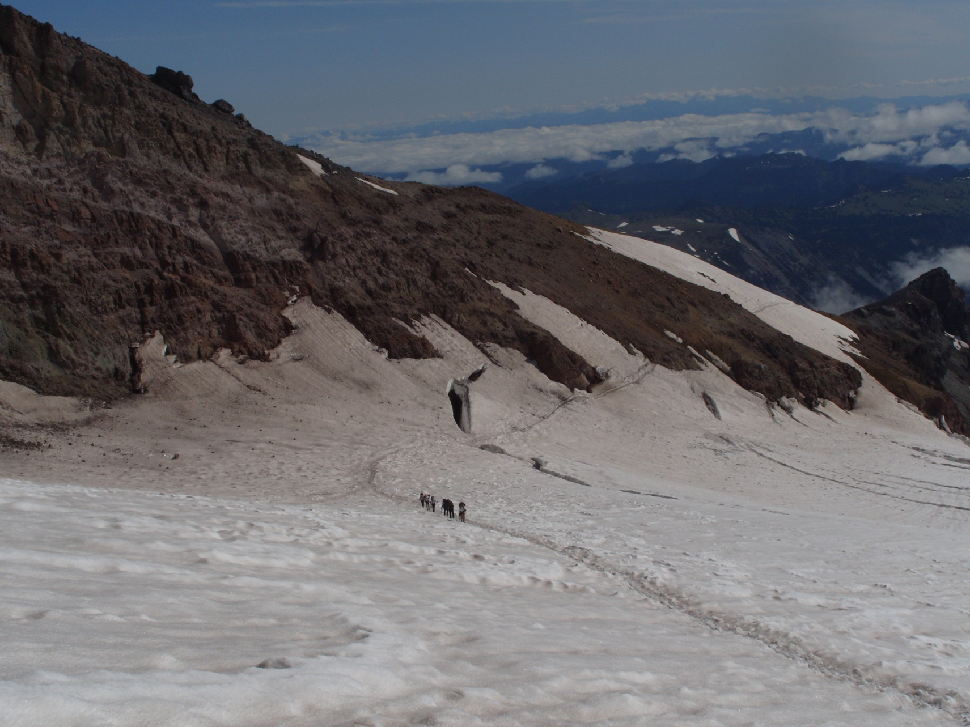
Snowbridges

Slide 11
Snowbridges
Formation
  Blown snow crystals stick to lips (if not too cold) and form cornices, which link to form snowbridges
  Flakes undergo age hardening to form stronger bonds over time
  Generally reform during fall/winter and collapse during spring/summer
Strength
  Many factors! Snow weight, solar radiation, temperature, humidity, wind, etc
  Many melt-freeze cycles result in dense “snow-ice”

Slide 12
Temperate Climate
e.g. Cascades, European Alps
  Glaciers: 1-10 miles long
  Winter
    wet with heavy snowfall (weather often poor for travel, most wands needed)
    Crevasses are hidden, but snowbridges strengthen over the course of fall
    Avalanches
  Spring
    Snowbridges begin to weaken and collapse
    May be able to use skis/sled (function of glacier and slope)
  Summer
    Dry with long days
    Crevasses begin to show; snowbridges continue to vanish
    Toward later season more navigation (= guess and check) required to ascend glacier; glacier may become icy or slushy – travel better at night
  Fall
    Light snow dusts glacier and can mask crevasses
    Snowbridges yet to form or are unrealiable

Slide 13
Other Climates
Subarctic – e.g. Alaska Range
  Winter-wet / summer-dry
  Snowbridges do not strengthen as much as on temperate glaciers due to less melt/freeze cycles (winter is too cold; less wet)
  Glaciers: up to over 30 miles long
  Meltwater on powdery snow causes more crevasse falls
Continental – e.g. Canadian Rockies, White Mtns
  Precipitation any time of year – weather windows are variable
Subtropical and Tropical – e.g. Himalaya, Andes
Polar regions – e.g. Greenland, Ellesmere Is., Poles (prohibitively expensive places to access)

Slide 14
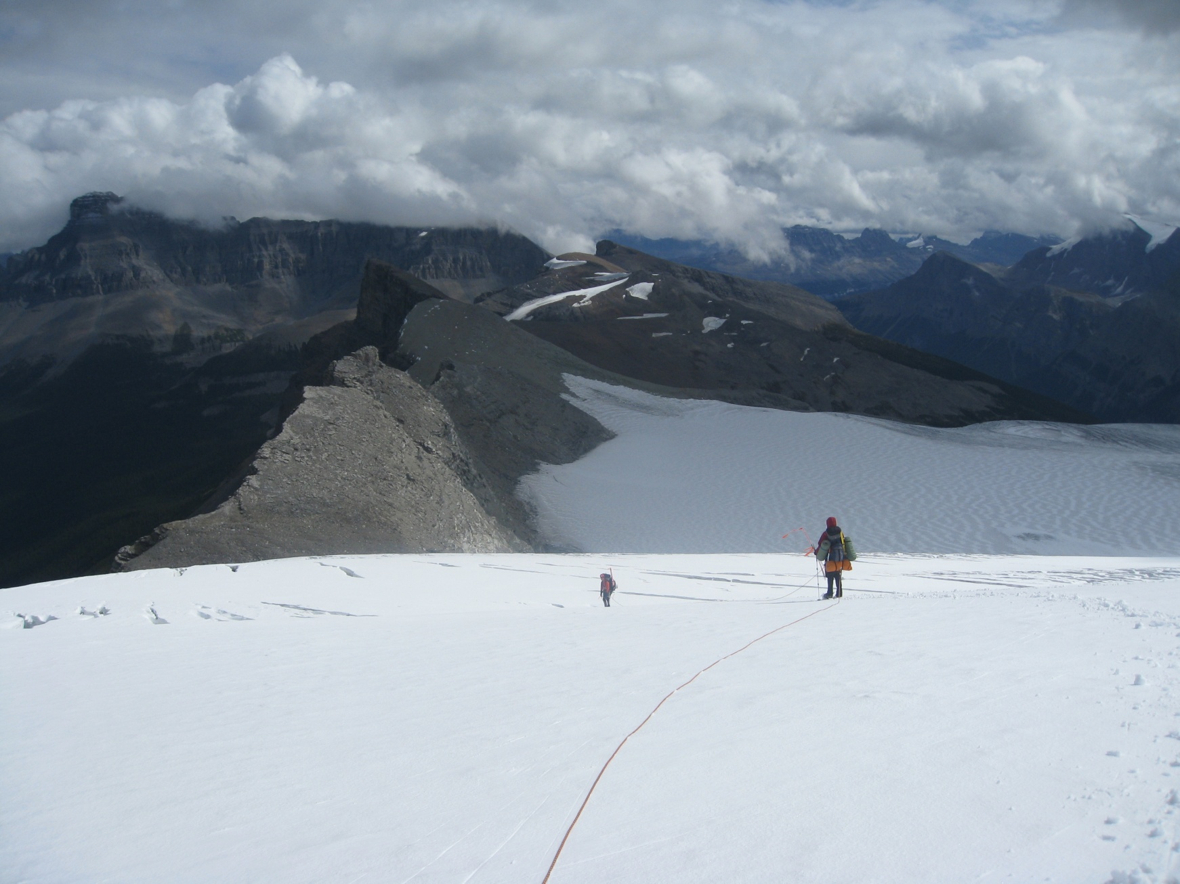
Roped Travel

Slide 15
Roped Travel
Roping up
  When the benefit from arresting a partner’s fall outweighs the hazard of literally tying your fate to one another
  Not helpful on icy slopes (can’t arrest)
  Not helpful where low risk of fall (hinders travel)
Tying in:
  Middles: eight on a bight
  Ends: tie directly in with an eight
Chest harness
  Pro: keeps you from flipping upside down in crevasse
  Con: harder to arrest partner’s fall
Harness above hipbone
Keep slack out of the rope, but do not keep completely taut or will pull on partners

Slide 16
Roped Travel
How far apart
  Longer span between people: bridge wider crevasses, more time to arrest, easier to make turns or other awkward motions
  Shorter span: less slack (fallen climber doesn’t go as far), easier to stay perpendicular to crevasses
  Also function of crevasse size: more slack for Alaska size glaciers in order to span hole
  Estimates:
    50m rope: 10m apart for 2-4 ppl, 12m for 5
    60m rope: 12m apart for 2-4 ppl, 15m for 5
    60m rope (Alaska): 18-20m apart for 2-4 ppl
    Slack stays with end climbers for rescue
    Arm span similar to height- pull rope to measure distance

Slide 17
Roped Travel
How many
  Three people: classic balance between movement efficiency and ability to rescue fallen climber
  Four or five: more power to hold falls, harder to maneuver. Can use two ropes- one party likely have to help group of two with anchor/haul if is fall
  Two people: very demanding to arrest fall AND fix anchor alone. Practice the Z x C!
  Solo: self-belay systems exist, also bridging systems. Unwise to say the least for novices

Slide 18
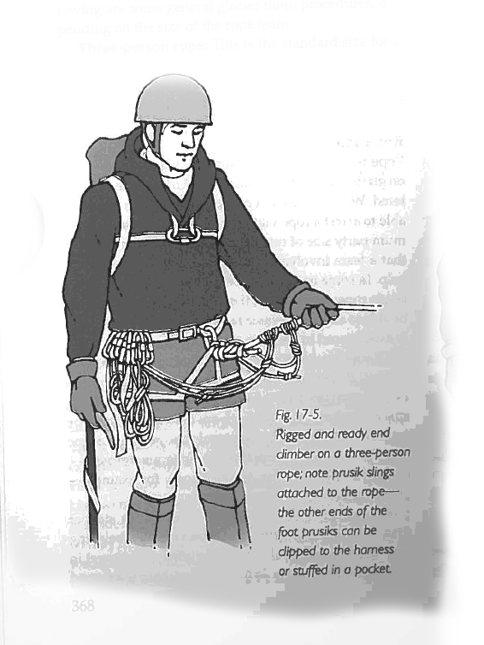
Tying In
Two options:
  Tie in directly or use a carabiner to clip into a figure 8 knot
  Tying in directly is sometimes recommended because it eliminates the extra link
    Use double bowline or butterfly knot
    Clip end to hardness so it cannot come untied
    - Leave some free rope at the ends for rescue use
    - Coil the free rope

Slide 19
Rope Management
No slack!
  Makes it easier to arrest if someone falls in because they get less speed
  Less chance you'll fall in the hole too
  Person doesn't fall in as much
Hold rope with downhill hand behind you to feel progress of people behind you
  Keep rope on downhill side of you so you avoid stepping on it
When switch backing up steep terrain
  Cross the rope onto other side when switch backing
  If turn is very tight, you may want to go outside of the original tracks, though this carries some risks
  Switch ice axe hands too.
    If you want to be lazy, don't use a leash.

Slide 20
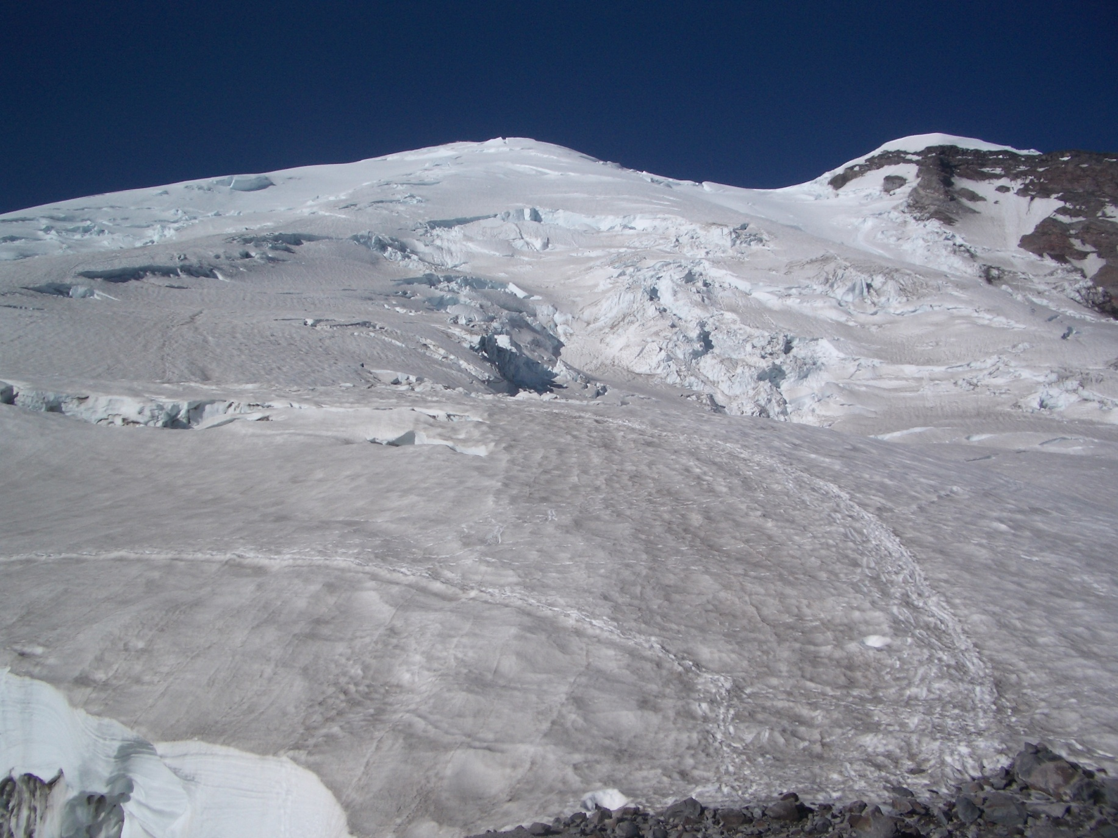
Routefinding

Slide 21
Routefinding
No trail, no cairns
Use wands – colored duct tape on garden stakes from hardware store
Crevasse maze
  Different every season/year – requires trial and error
  Travel farther in late season
Perspective of route changes with ascension – plan and readjust
Rope leader (person in front) often makes smaller scale decisions alone (i.e. route through dense crevasse field)
Can probe snowbridges on route with hiking pole to test sturdiness
Covered crevasses may look like old trails
Boottrack becomes less reliable over time
Altimeters, maps, compasses, gps
Whiteouts

Slide 22
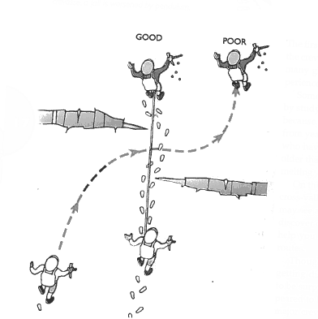
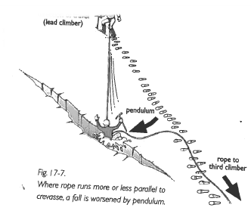
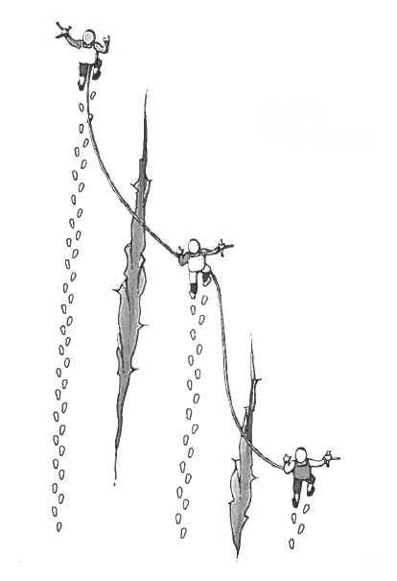
Travel
Keep rope at right angle to crevasse when possible
      Reduces a lengthy pendulum fall
    If you have to walk parallel to crevasses, use echelon formation

Slide 23
Travel
Play find the crevasse!
  Just because you can't see it, doesn't mean it's not there
  Send scout party to search for crevasses in daylight the day
Snow probing (while walking):
  Use ice axe, or better a hiking pole without the basket
  Thrust into snow to test if the resistance to the thrust is uniform
  - If not, you may have broken into a hole
  - Once found, establish the extent of the hole

Slide 24
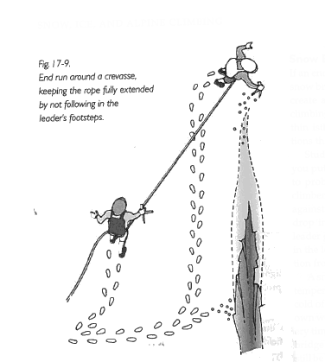
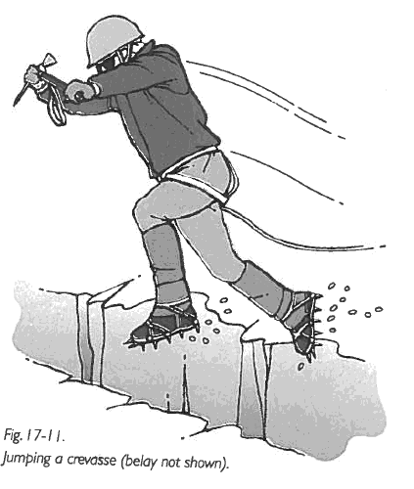
Crossing a crevasse
Walk around it
If impractical, use a snow bridge
  Study it carefully
  Get side view
  Get close-up view while second climber braces or belays you
  Follow leader's footsteps exactly
Jumping
  Last resort
  Spool out rope
  Have ice axe out to self arrest on other side
  Keep feet far apart
Going inside (if shallow)

Slide 25
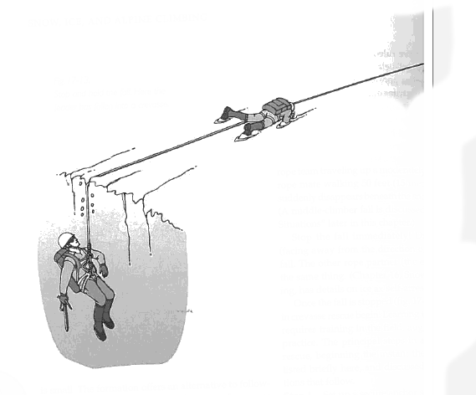
When Falling
Yell "falling"
- Others self arrest
Rescue
  Next class ☺

Slide 26
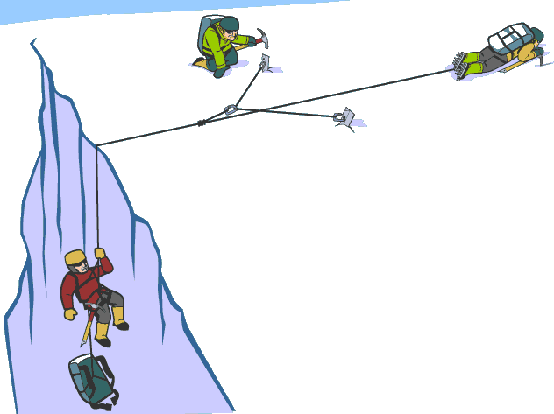
Coming Soon (now?)
More on when to rope up
Ascending the rope
Rescue and hauling systems
Protection and equipment required

Slide 27
Reference

Slide 28
Trip Planning
What to bring
  Gear list w/ personal gear, group gear, maybe weight
Beta
  Internet helpful but inadequate; need guide, guidebook or (a lot of) experience
Logistics
  Are roads open; passable with intended vehicle?
  Is a plane/helicopter required?
  Will my gear fit / is it allowed in my checked luggage?
Emergency plans
  WIMP: local contact info
  Radio, GPS, sat phone

Slide 29
Other topics
Travel at night
Remoteness
Where to camp
Rock fall
Sleds

